Slide 1

Internship Project
on
Website and Application Development for Vegetable Market Logs
Project Manager and Mentor:
Mr. Yuvraj Joshi
Assistant Professor,
Department of Computer Science & Engineering
Graphic Era Deemed to be University, Dehradun,
Uttarakhand, India (248002)

Slide 2
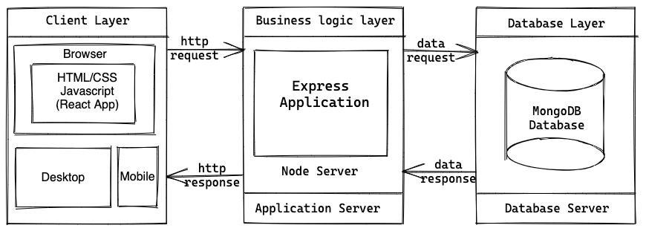

Slide 3
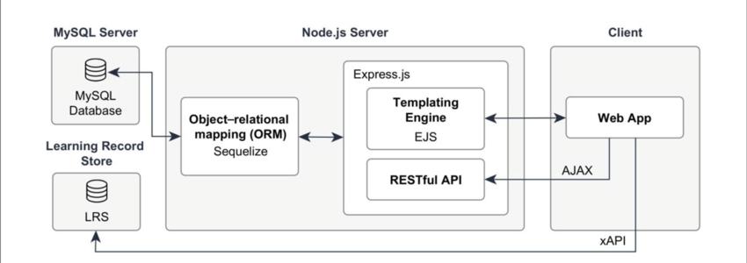

Slide 4
- What is ORM? - What is the role of ORM in the context of Node.js? - Is it good to use it or not? - Can it be used with Mongo DB or not?

Slide 5
ORM
ORM stands for Object-Relational Mapping.
It is a programming technique that allows developers to interact with a relational database using an object-oriented paradigm.
It bridges the gap between the object-oriented code in your application and the relational database, making it easier to perform CRUD operations (Create, Read, Update, Delete) on the database using familiar programming constructs.

Slide 6
ORM
ORM is a popular choice for database access because Node.js itself is built on a non-blocking, asynchronous event-driven architecture.
As a result, traditional synchronous database access methods can lead to blocking behavior and hinder the scalability and performance advantages of Node.js.

Slide 7
ORM
The role of ORM in Node.js is to provide a layer of abstraction over the database, allowing you to work with JavaScript objects and classes instead of writing raw SQL queries.
This abstraction simplifies database operations, reduces boilerplate code, and makes your codebase more maintainable.
Developers can define models and relationships in the code, and the ORM handles the translation of these models into SQL queries or other database-specific commands.
Some popular ORM libraries for Node.js include Sequelize, TypeORM, and Mongoose (for MongoDB).

Slide 8
ORM (Yay or Nay)
Advantages of using ORM:
Abstraction: ORM abstracts away the database-specific details, allowing developers to focus more on application logic and less on writing raw SQL queries.
Portability: Since the ORM handles the underlying database interactions, it becomes easier to switch between different databases without rewriting significant portions of your codebase.
Security: Most ORMs handle SQL injection prevention, making it safer to interact with the database.
Disadvantages of using ORM:
Performance Overhead: ORM introduces an additional layer of abstraction, which can sometimes lead to a slight performance overhead compared to writing raw SQL queries, especially for complex operations.
Learning Curve: Developers need to learn the ORM's API and concepts, which might take some time initially.
Limited Database-Specific Features: Some advanced database-specific features might not be directly supported by the ORM, and you may need to write raw queries in such cases.

Slide 9
ORM (feasibility with Mongo DB)
As for using ORM with MongoDB, the situation is a bit different. MongoDB is a NoSQL database, and the ORM concept doesn't apply directly since there is no relational schema. Instead, you would typically use an ODM (Object-Document Mapping) library for MongoDB.
Mongoose is a popular ODM library for MongoDB in Node.js. It allows you to define schemas and models for your data, providing similar benefits to ORM, but tailored for working with MongoDB's document-based structure.
To summarize, using an ORM or ODM in your Node.js project can be beneficial, especially when working with relational databases or MongoDB. It simplifies database interactions and improves code maintainability. However, it's essential to weigh the advantages and disadvantages of using ORM/ODM in the specific context of your project and its requirements.

Slide 10
- What is ODM? - What is the role of ODM in context Node JS and Mongo DB?

Slide 11
ODM
ODM stands for Object-Document Mapping.
It is similar to ORM (Object-Relational Mapping), but instead of mapping objects to relational databases, it maps objects to document-based databases like MongoDB.
ODM provides a layer of abstraction that allows developers to work with JavaScript objects and classes to interact with the database, rather than dealing with raw MongoDB queries directly.

Slide 12
Mongoose ODM
In the context of Node.js and MongoDB, an ODM library like Mongoose is widely used.
Mongoose simplifies working with MongoDB by providing schema-based modeling and validation for your data.
It allows you to define models for your data with a clear structure, data types, and relationships, making it easier to manage and manipulate your MongoDB collections.

Slide 13
Mongoose ODM
The role of ODM (Mongoose) in Node.js and MongoDB can be broken down into several key aspects:
1. Schema Definition:
With Mongoose, you define a schema that represents the structure of your documents in the MongoDB collection. The schema defines the fields, their types, default values, validation rules, and more. It enforces a consistent structure across documents in the collection.
Example:
Let's say we want to model a simple blog post with a title, content, and a date. We can define a Mongoose schema for it:
const mongoose = require('mongoose');
const blogPostSchema = new mongoose.Schema({
title: {
type: String,
required: true,
},

Slide 14
Mongoose ODM
content: {
type: String,
required: true,
},
date: {
type: Date,
default: Date.now,
},
});
const BlogPost = mongoose.model('BlogPost', blogPostSchema);

Slide 15
Mongoose ODM
The role of ODM (Mongoose) in Node.js and MongoDB can be broken down into several key aspects:
2. Model Creation:
Once the schema is defined, you create a Mongoose model based on that schema. The model acts as an interface to the MongoDB collection, allowing you to perform CRUD operations on documents.
Example:
In the previous example, we created a model for the blog post using `mongoose.model`. The model name is 'BlogPost', and it will interact with the MongoDB collection named 'blogposts'.

Slide 16
Mongoose ODM
The role of ODM (Mongoose) in Node.js and MongoDB can be broken down into several key aspects:
3. Validation and Middleware:
Mongoose allows you to define validation rules for your fields, ensuring that only valid data is stored in the database. Additionally, you can define pre-save and post-save middleware functions that can perform operations before or after saving data to the database.
Example:
Let's add a validation rule to the blog post schema to limit the title length to 100 characters:
const blogPostSchema = new mongoose.Schema({
title: {
type: String,
required: true,
maxlength: 100,
},
// ... rest of the schema ...
});

Slide 17
Mongoose ODM
The role of ODM (Mongoose) in Node.js and MongoDB can be broken down into several key aspects:
4. Querying and Data Manipulation:
Mongoose provides an expressive API to perform queries on your MongoDB collections. You can find, create, update, and delete documents using Mongoose methods, which automatically generate MongoDB queries for you.
Example:
To create a new blog post and save it to the database:
const newBlogPost = new BlogPost({
title: 'Sample Post',
content: 'This is the content of the blog post.',
});

Slide 18
Mongoose ODM
newBlogPost.save((err, savedPost) => {
if (err) {
console.error('Error saving blog post:', err);
} else {
console.log('Blog post saved successfully:', savedPost);
}
});

Slide 19
Mongoose ODM
The role of ODM (Mongoose) in Node.js and MongoDB can be broken down into several key aspects:
5. Relationship Management:
Mongoose also allows you to define and manage relationships between different models, making it easier to work with related data.
Example:
If you had a "User" model, you could reference it in the "BlogPost" model to represent an author for each blog post:
const blogPostSchema = new mongoose.Schema({
title: { type: String, required: true },
content: { type: String, required: true },
date: { type: Date, default: Date.now },
author: { type: mongoose.Schema.Types.ObjectId, ref: 'User' },
});
In this example, the "author" field references a User model's ObjectId.

Slide 20
Mongoose ODM
In the context of Node.js and MongoDB simplifies database interactions by providing schema-based modeling, validation, and an expressive API for querying and manipulating data.
It enables developers to work with MongoDB in a more structured and organized manner, similar to using ORM with relational databases.

Slide 21
- What is the difference between Mongo Db and SQL databases? - Which one of them is better in the terms of industrial aspects? - How mongoose ODM has helped Mongo DB to become better?

Slide 22
Mongo DB vs SQL Databases
MongoDB and SQL databases (also known as relational databases) are two fundamentally different types of databases, each with its strengths and weaknesses. The choice between them depends on the specific requirements of your application and the nature of the data you are dealing with. Let's explore the main differences between MongoDB and SQL databases:
1. Data Model:
- MongoDB: MongoDB is a NoSQL database, which means it follows a flexible, schema-less data model. It stores data in JSON-like BSON (Binary JSON) documents, allowing each record to have different fields and structures. This flexibility is well-suited for applications with rapidly evolving or unpredictable data structures.
- SQL Databases: SQL databases use a structured schema, where data is stored in tables with fixed columns and data types. The schema defines the relationships and constraints between different tables, making it suitable for applications with well-defined and stable data structures.

Slide 23
Mongo DB vs SQL Databases
2. Query Language:
- MongoDB: MongoDB uses a rich query language that allows you to perform complex queries, including filtering, aggregation, and geospatial queries. MongoDB's query language is more expressive and suitable for handling unstructured or semi-structured data.
- SQL Databases: SQL databases use SQL (Structured Query Language) for querying data. SQL provides powerful capabilities for handling structured data, joining tables, and performing advanced analytics.

Slide 24
Mongo DB vs SQL Databases
3. Scalability:
- MongoDB: MongoDB is designed to scale horizontally, meaning it can distribute data across multiple servers, making it easier to handle large amounts of data and high-traffic applications.
- SQL Databases: While SQL databases can also be scaled, they typically require more effort and planning, especially when dealing with massive amounts of data.

Slide 25
Mongo DB vs SQL Databases
4. Transactions:
- MongoDB: Historically, MongoDB lacked full support for multi-document transactions. However, recent versions have introduced some transaction support, but it may not be as mature as in SQL databases.
- SQL Databases: SQL databases have well-established support for transactions, which ensures data integrity and consistency during complex operations.

Slide 26
Mongo DB vs SQL Databases
5. Use Cases:
- MongoDB: MongoDB is often preferred for use cases where the data schema evolves frequently or where a flexible, agile approach to data storage is required. It is suitable for applications like real-time analytics, content management systems, and social media platforms.
- SQL Databases: SQL databases are generally a better fit for applications with stable, well-defined data structures and when complex transactions are involved. They are commonly used in applications like e-commerce, financial systems, and enterprise resource planning (ERP) systems.

Slide 27
Mongo DB vs SQL Databases
As for which one is better in terms of industrial aspects, there is no definitive answer. Both MongoDB and SQL databases are widely used and have their own strengths based on the specific requirements of a project. The choice depends on factors like data complexity, scalability needs, development team expertise, and project goals.

Slide 28
- How Mongoose ODM has helped MongoDB become better?

Slide 29
Mongoose + MONGO
1. Schema Definition and Validation:
MongoDB, being a NoSQL database, does not enforce a fixed schema. However, in real-world applications, having some structure and validation for data is often beneficial. Mongoose brings schema-based modeling to MongoDB, providing developers with the advantages of defining clear data structures, data types, and validation rules. This promotes data consistency and helps catch errors early in the development process.

Slide 30
Mongoose + MONGO
2. Relationship Management:
MongoDB does not have built-in support for enforcing relationships between documents, unlike SQL databases with foreign keys. Mongoose allows developers to define and manage relationships between different models, making it easier to work with related data and providing more structure to your data model.

Slide 31
Mongoose + MONGO
3. Middleware and Hooks:
Mongoose introduces middleware and hooks, which are functions that can be executed before or after certain database operations. This gives developers more control over data manipulation and allows for custom validation, pre-processing, or post-processing of data.

Slide 32
Mongoose + MONGO
4. Query Building and Population:
Mongoose provides an expressive API for building queries, making it easier to perform complex searches and aggregations. Additionally, it supports population, allowing you to automatically resolve references to other documents based on defined relationships.

Slide 33
Mongoose + MONGO
5. Community and Ecosystem:
Mongoose has a large and active community, contributing to its continuous improvement and providing various plugins and extensions that enhance MongoDB's capabilities. This vibrant ecosystem makes it easier for developers to work with MongoDB in the Node.js environment.

Slide 34
Mongoose + MONGO
Mongoose ODM has significantly improved MongoDB's appeal and usability by providing a more structured approach to data modeling, validation, and relationship management.
The choice between MongoDB and SQL databases still depends on the specific needs of your project and the nature of the data you are dealing with.
Both have their merits, and the decision should be based on a careful evaluation of your application requirements and development team expertise.

Slide 35
<thanks/>

